Slide 1
ENGI 301 Plant Maintenance Device Proposal
09/27/22
Liam Merva

Slide 2
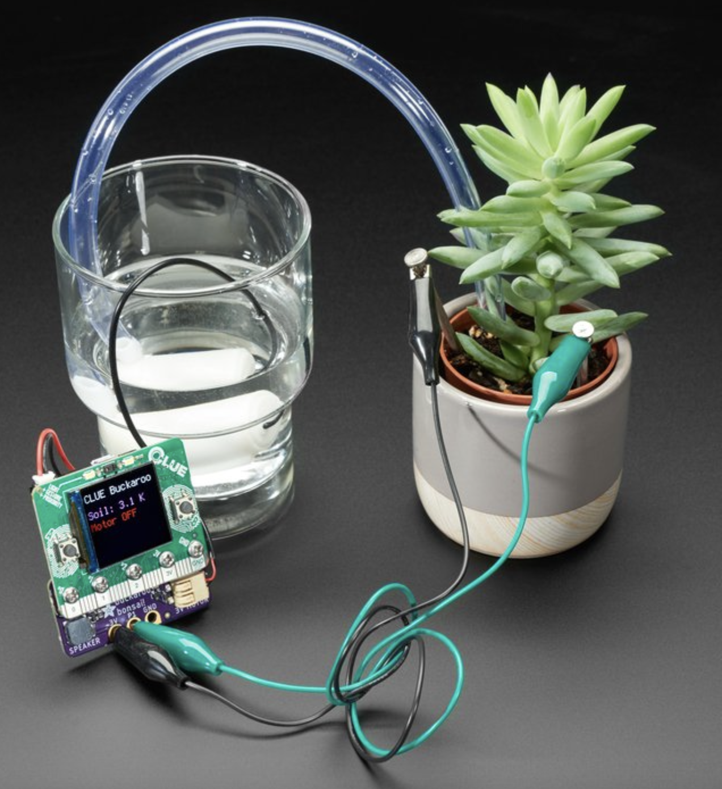
Background Information
Plants are something that always brighten up or improve the aesthetic in a room. There is a innate neurological benefit from keeping nature in close proximity indoors. However, I have always struggled to keep plants because I forget to water/care for them. Thus, I want to not only develop a program to sense when a plant needs water or light, but also automatically delivers water to it when it is required. The only manual labor required would be refilling the water. This is inspired by one of my friend’s quarantine projects where he built a device to water his garden. This also plays into my senior project, where I have to monitor a microenvironment and automatically apply medication/heat based on the circumstances of said environment.
Basing it off a former ENGI 301 project by Fernanda Lago: (https://www.hackster.io/fernandalago/plant-reminder-box-473f95)
Links to existing projects / libraries
Improvements are the automated water dispenser

Slide 3
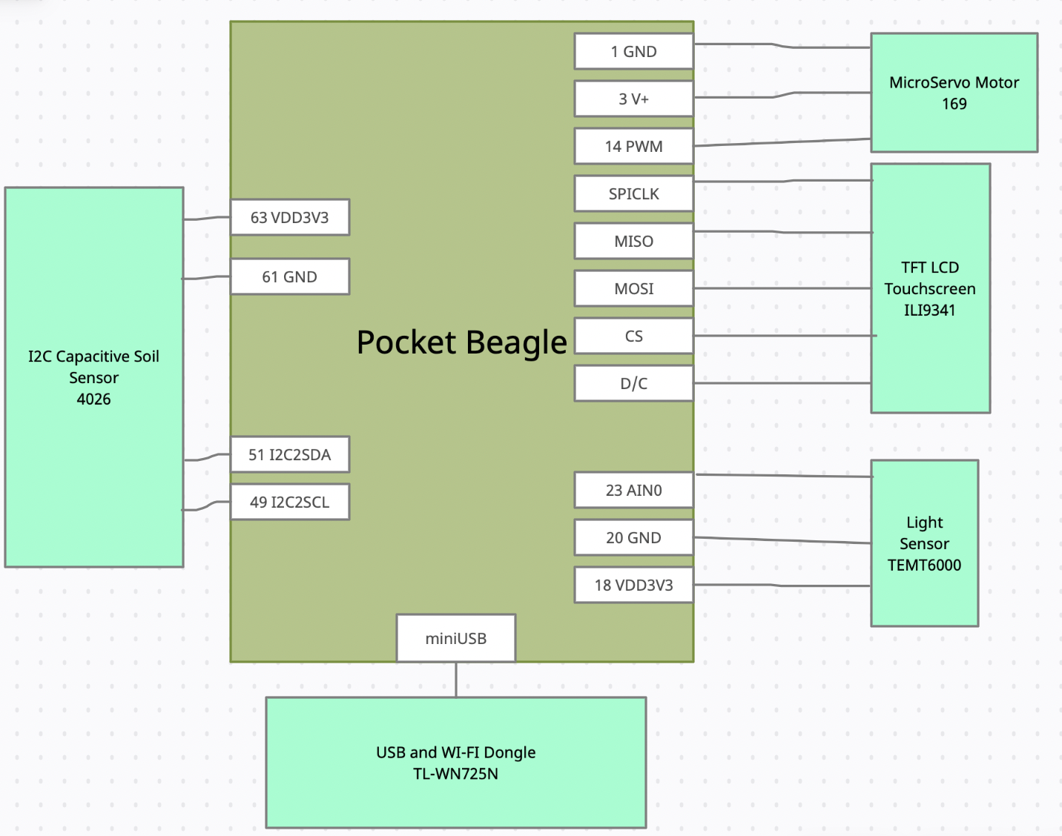
System Block Diagram
USB and WI-FI Dongle is optional, do not think it is necessary for my project
Need help with MicroServo motor connections/not sure if I need multiple MicroServo motors

Slide 4
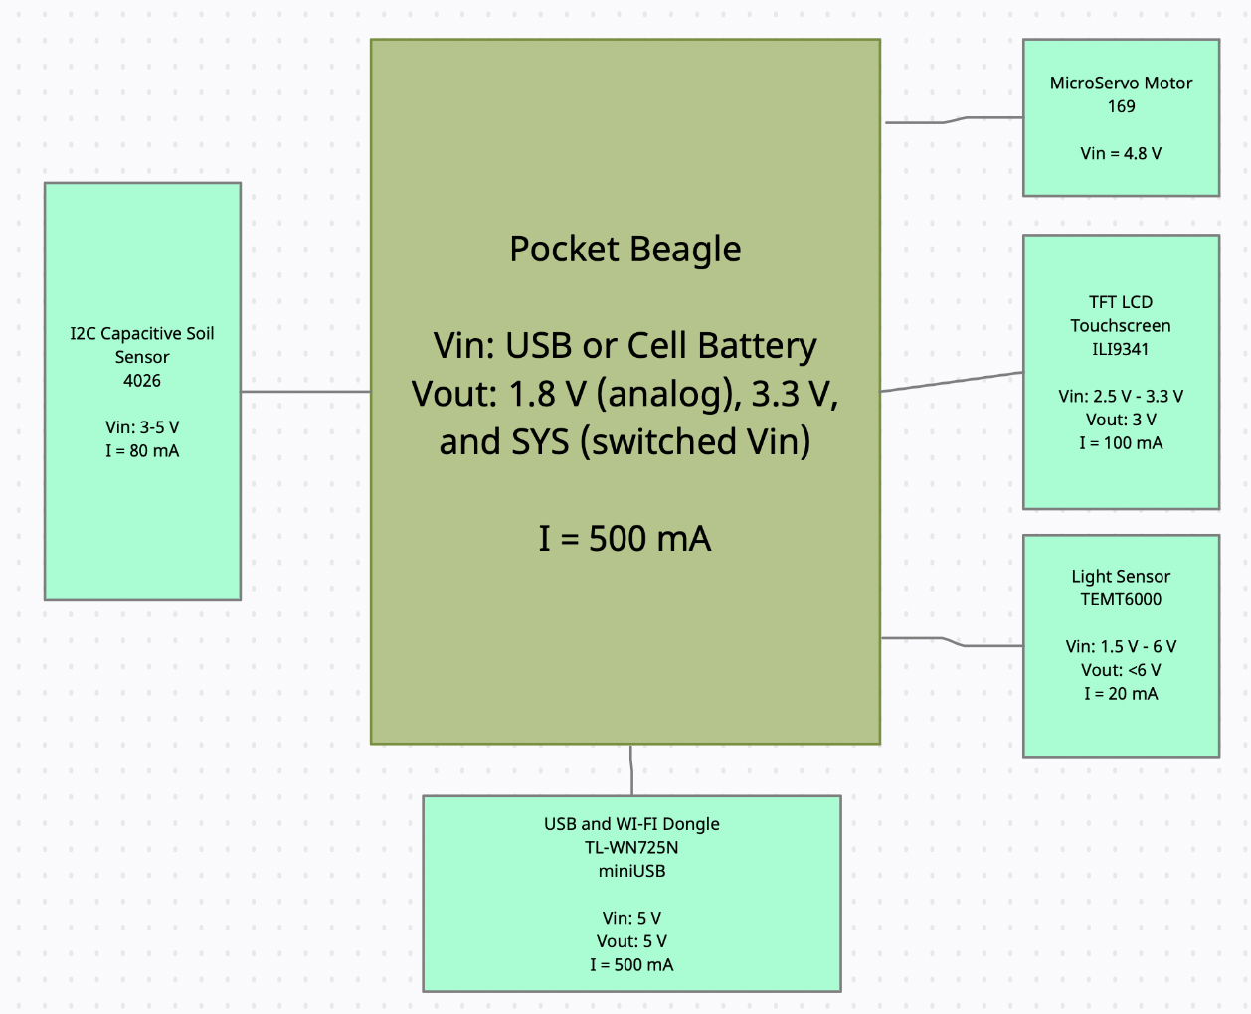
Power Block Diagram
Could not find current for MicroServo Motor
All values were pulled from datasheet/previous project

Slide 5
Components / Budget
Component | Need to Buy | Cost
Micro servo | Yes | $5.95
SparkFun Ambient Light Sensor Breakout (TEMT 6000) | Yes | $4.95
2.8" TFT LCD with Touchscreen Breakout Board w/MicroSD Socket - ILI9341 | Yes | $29.95
Adafruit STEMMA Soil Sensor - I2C Capacitive Moisture Sensor | Yes | $7.50
TP-Link USB WiFi Adapter | No | $10
Need all components to be purchased by instructor listed; additional components may be purchased by student

